Slide 1
Kidney Exchange Program
Kjartan Þór Birgisson

Slide 2
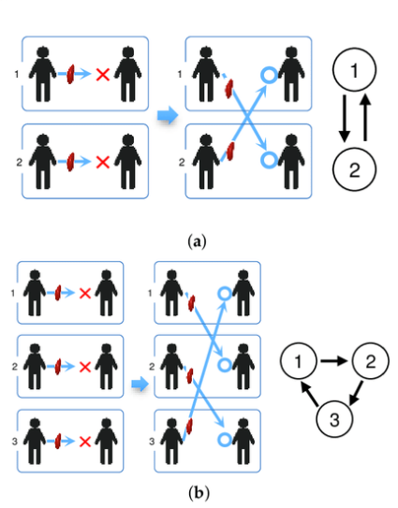
Kidney Exchange Program: Concept
A person in need of kidney transplant might have multiple persons willing to donate them a kidney.
No donor from that pool might be compatible.
People are much more likely to donate kidney to a friend or relative then a total stranger.
Solution: Create a pool of people in need of kidney transplant and along with the people willing to donate them a kidney.
Form kidney chains.

Slide 3
Kidney Exchange Program: History
First implemented in New England 2004 – 2005.
Alvin E. Roth – 2012 Nobel Memorial Prize in Economic Sciences.
Has been implemented all over the world.
3-way kidney chains considered optimal.
Longest kidney chain ever: 12-way exchange.

Slide 4
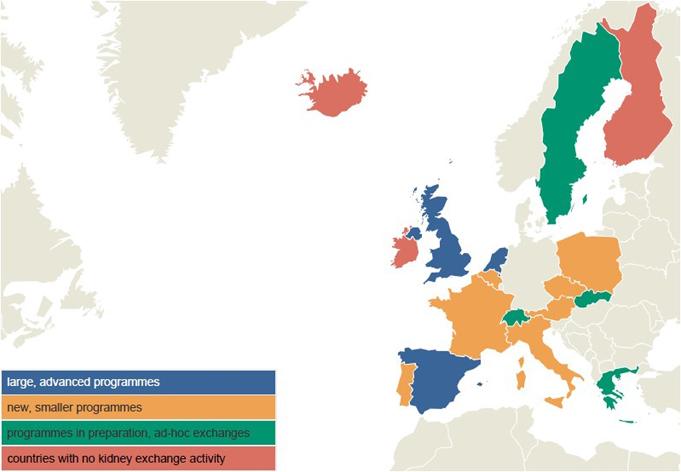
Kidney Exchange Programs: Europe

Slide 5
Kidney Exchange Program: Compatibility
Object: Minimize the likelyhood of kidney being rejected by kidney transplant recipient.
Blood Type: ˈAˈ, ˈBˈ, ˈABˈ, ˈOˈ
ˈOˈ can receive kidney from ˈOˈ
ˈAˈ can receive kidney from ˈAˈ or ˈOˈ
ˈBˈ can receive kidney from ˈBˈ or ˈOˈ
ˈABˈ can receive kidney from ˈABˈ, ˈAˈ, ˈBˈ or ˈOˈ
Rhesus (+/-), not important
Donor‘s Physical Condition: Age, BMI, eGFR, SBP, History of Smoking

Slide 6
Kidney Exchange Program: Compatibility
HLA Antigen Matches
HLA-A
HLA-B
HLA-DR
Transplants performed even though several HLA mismatches exist

Slide 7
Kidney Exchange Program: Dataset
Complete:
Bloodtype Distribution - Vísindavefur
BMI Distribution – Landlæknir
History of Smoking Distribution – Landlæknir
Incomplete:
Systolic Blood Pressure Distribution – Hjartavernd
Heritage – Hagstofan
Missing:
HLA mismatches – deCode
eGFR – Landspítalinn

Slide 8
Kidney Exchange Program: Method
Genetic Algorithm
Sequence with Permutations
Objective Functions:
Longest possible kidney chain
Higher risk of kidney rejection
Logistical problems
Maximum kidney distribution
Higher risk of kidney rejection
Lowest risk kidney chain
Lowest risk of kidney rejection
Will favor a slightly lower risk 2-way exchange over a 3-way exchange
Constrained kidney chain size – Lowest risk kidney chain of that size selected
Accounts for logistics, f. ex. amount of kidney transplants possible at the same time

Slide 9
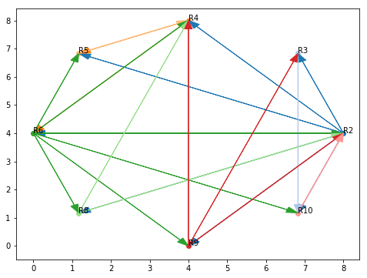
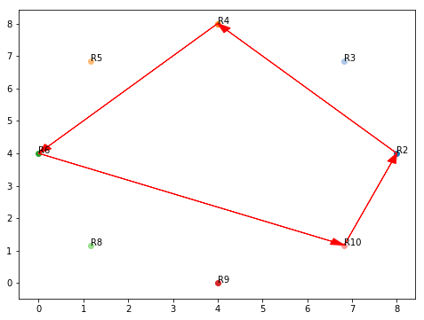
Kidney Exchange Program: Results
Possible Kidney Exchanges
Best 4-way Exchange Kidney Chain

Slide 10
Kidney Exchange Program: Results
Donor #1 | Recipient #1 | Donor #2 | Recipient #2
Bloodtype: ˈOˈ History of Smoking: 0.0 Age: 34 eGFR: 108.85 BMI: 18.0 African Heritage: 0 SBP: 122.0 Gender: 0 | Bloodtype: ˈBˈ History of Smoking: 1.0 Age: 55 eGFR: 60.42 BMI: 19.0 African Heritage: 0 SBP: 120.0 Gender: 1 | Bloodtype: ˈOˈ History of Smoking: 0.0 Age: 51 eGFR: 62.18 BMI: 21.0 African Heritage: 0 SBP: 120.0 Gender: 1 | Bloodtype: ˈOˈ History of Smoking: 0.0 Age: 29 eGFR: 97.76 BMI: 30.0 African Heritage: 0 SBP: 108.0 Gender: 1
Unrelated: 1.0 HLA-B Mismatches: 2.0 HLA-DR Mismatches: 1.0 |  | Unrelated: 1.0 HLA-B Mismatches: 0.0 HLA-DR Mismatches: 1.0
Donor #3 | Recipient #3 | Donor #4 | Recipient #4
Bloodtype: ˈOˈ History of Smoking: 0.0 Age: 19 eGFR: 104.52 BMI: 24.0 African Heritage: 0 SBP: 122.0 Gender: 0 | Bloodtype: ˈAˈ History of Smoking: 1.0 Age: 44 eGFR: 88.55 BMI: 18.0 African Heritage: 0 SBP: 122.0 Gender: 0 | Bloodtype: ˈOˈ History of Smoking: 0.0 Age: 36 eGFR: 86.52 BMI: 20.0 African Heritage: 0 SBP: 122.0 Gender: 0 | Bloodtype: ˈAˈ History of Smoking: 0.0 Age: 27 eGFR: 81.81 BMI: 27.0 African Heritage: 0 SBP: 108.0 Gender: 1
Unrelated: 1.0 HLA-B Mismatches: 1.0 HLA-DR Mismatches: 0.0 |  | Unrelated: 1.0 HLA-B Mismatches: 1.0 HLA-DR Mismatches: 1.0

Slide 11
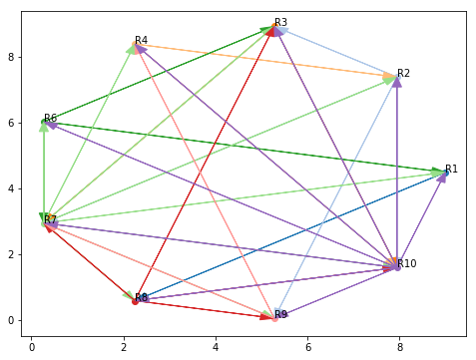
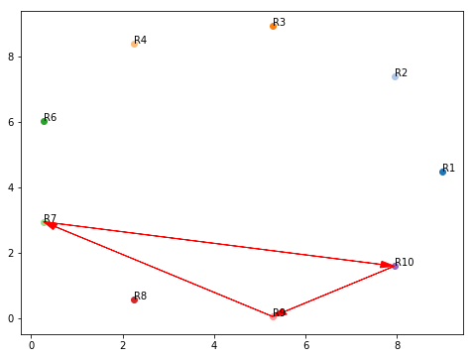
Kidney Exchange Program: Results
Possible Kidney Exchanges
Best 3-way Exchange Kidney Chain

Slide 12
Kidney Exchange Program: Results
Donor #1 | Recipient #1 | Donor #2 | Recipient #2 | Donor #3 | Recipient #3
Bloodtype: ˈOˈ History of Smoking: 0.0 Age: 21 eGFR: 85.84 BMI: 21.0 African Heritage: 0 SBP: 108.0 Gender: 1 | Bloodtype: ˈAˈ History of Smoking: 0.0 Age: 28 eGFR: 84.94 BMI: 35.0 African Heritage: 0 SBP: 108.0 Gender: 1 | Bloodtype: ˈOˈ History of Smoking: 0.0 Age: 18 eGFR: 107.16 BMI: 23.0 African Heritage: 0 SBP: 108.0 Gender: 1 | Bloodtype: ˈOˈ History of Smoking: 0.0 Age: 39 eGFR: 82.03 BMI: 24.0 African Heritage: 0 SBP: 108.0 Gender: 1 | Bloodtype: ˈOˈ History of Smoking: 0.0 Age: 18 eGFR: 114.72 BMI: 27.0 African Heritage: 0 SBP: 122.0 Gender: 0 | Bloodtype: ˈABˈ History of Smoking: 1.0 Age: 38 eGFR: 76.77 BMI: 22.0 African Heritage: 0 SBP: 108.0 Gender: 1
Unrelated: 1.0 HLA-B Mismatches: 0.0 HLA-DR Mismatches: 1.0 |  | Unrelated: 1.0 HLA-B Mismatches: 1.0 HLA-DR Mismatches: 2.0 |  | Unrelated: 1.0 HLA-B Mismatches: 1.0 HLA-DR Mismatches: 1.0

Slide 13
Kidney Exchange Program: Further work
Obtain the minimum criteria used by the Icelandic Health Care System to evaluate Donor/Recipient compitability - Ongoing
Obtain the incomplete and missing datasets in order to properly represent the Icelandic population
Estimate if a Kidney Exchange Program could be economically benificial for the Icelandic Health Care System

